Slide 1
BITS Pilani presentation
Yogesh B
Introduction to DevOps

Slide 2
CSIZG514/SEZG514, Introduction to DevOps
Lecture No. 6

Slide 3
Agenda
Introduction to build
Build automation and Build tools

Slide 4
Build automation and Build tools
Build tools
Build tools automate software builds
Usually, a software build consists of a number of steps that are dependent on each other
In detail the sequence of events depends, on which programming language is used and for which target platform software is developed
The following phases are generally part of a build:
  Compiling the source code to binary code
  Running and evaluating unit tests
  Processing existing resource files (for example, configurations)
  Generating artifacts that can be used later (for example, WAR or EAR files, Debian packages)

Slide 5
Build automation and Build tools
Build tools Contd..
Additional steps that are often executed in the a build and that can likewise be automated with the employed build tools are:
  Administering dependencies of, for instance the libraries that are used in the project
  Running additional tests, such as acceptance and load tests
  Analyzing code quality and examining defined conventions in the source code (static code analysis)
  Archiving generated artifacts and packages in a central repository

Slide 6
Build automation and Build tools
Build tools Contd..
Maven
Gradle
Technology | Tool
Rails | Rake
.Net | MsBuild
Java | Ant, Maven, Buildr, Gradle
C,C++ | SCons

Slide 7
Agenda
Build Tools – Maven and Gradle
Maven
Gradle

Slide 8
Build Tool - Maven
History
Maven, a Yiddish word meaning accumulator of knowledge
Originally started as an attempt to simplify the build processes in the Jakarta Turbine project
Concept behind building Maven?
  There were several projects each with their own Ant build files that were all slightly different and JARs were checked into CVS
  Need of a standard way to build the projects, a clear definition of what the project consisted of, an easy way to publish project information and a way to share JARs across several projects
The result is a tool that can now be used for building and managing any Java-based project

Slide 9
Build Tool - Maven
History
With maven, day-to-day work of Java developers get easier and generally it help with the understanding of any Java-based project
Maven addresses two aspects of building software
  describes how software is built
  describes its dependencies
Maven can also be used to build and manage projects written in C#, Ruby, Scala, and other languages
The Maven project is hosted by the Apache Software Foundation, where it was formerly part of the Jakarta Project
And Initial Release of Maven was : 13 July 2004; 14 years ago

Slide 10
Build Tool - Maven
Software
Maven is a software which collects all your dependency find it from all over internet compile your classes and provide you the final jar/war
JAR: Java Archive Files
WAR: Web Application Resource or Web Application Achieve Files
EAR: Enterprise Archive

Slide 11
Build Tool - Maven
Objective
Making the build process easy
Providing a uniform build system
Providing quality project information
Providing guidelines for best practices development
Allowing transparent migration to new features

Slide 12
Build Tool - Maven
Phases of a standard Maven build
Currently, Maven is likely the most widely used build tool for Java especially in large enterprises
Maven default life cycle comprises a number of predefined and fixed phases
  First, the source files are verified, and the build is initialized
  Subsequently, the sources and resources are compiled and processed
  The same happens with test sources and resources
  Afterwards, the result is packaged, and optionally an integration test is run
  Finally, the result can be verified, installed, and deployed in an artifact repository
Not all actions are necessarily executed in each phase
In this way Maven offers a skeleton along which your own build logic can be oriented

Slide 13
Build Tool - Maven
Phases of a standard Maven build
Standardized phases, the commands for the compilation and testing of software are the same in each Maven project:
mvn package executes all phases up to packaging and creates a build
mvn test stops at the phase “test.”
validate
compile
test-compile
package
integration test
post-integration test
verify
install
deploy

Slide 14
Build Tool - Maven
Maven POM
Stands for Project Object Model
Describes a project
  Name and Version
  Artifact Type
  Source Code Locations
  Dependencies
  Plugins
  Profiles (Alternate build configurations)
  Uses XML by Default

Slide 15
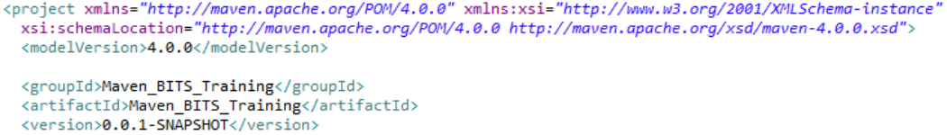
Build Tool - Maven
Project Name (GAV)
Maven uniquely identifies a project using
groupID: Arbitrary project grouping identifier (no spaces or colons)
  Usually loosely based on Java package
artfiactId: Arbitrary name of project (no spaces or colons)
  version: Version of project
  Format {Major}.{Minor}.{Maintenance}
  Add ‘-SNAPSHOT ‘ to identify in development
GAV Syntax: groupId:artifactId:version

Slide 16
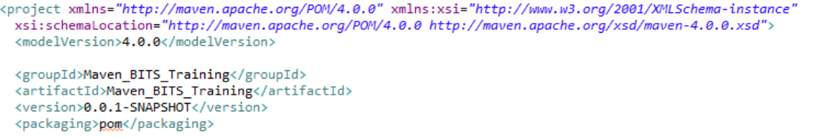
Build Tool - Maven
Packaging
Build type identified using the “packaging” element
Tells Maven how to build the project
Example packaging types: – pom, jar, war, ear, etc.
Default is jar

Slide 17
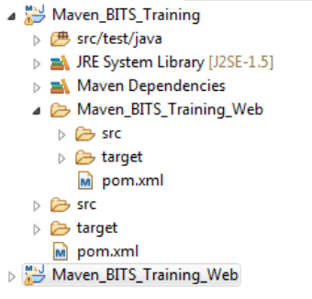
Build Tool - Maven
Multi Module Projects
Maven has 1st class multi-module support
Each maven project creates 1 primary artifact
A parent pom is used to group modules

Slide 18
Build Tool - Maven
Example Maven Goals
mvn install
  Invokes generate* and compile, test, package, integration-test, install
mvn clean
  Invokes just clean
mvn clean compile
  Clean old builds and execute generate*, compile
mvn compile install
  invokes generate*, compile, test, integration-test, package, install
mvn test clean
  Invokes generate*, compile, test then clean

Slide 19
Build Tool - Gradle
About Gradle
Gradle is an open-source build automation tool focused on flexibility and performance
Gradle build scripts are written in Domain Specific Language [DSL], i.e. Groovy
Groovy resembles Java
Every Java program is also a valid Groovy program, Groovy offers options for writing programs with substantially easier syntax
Why Consider Gradle?
  High performance
    It is very specific on running only required tasks; which have been changed
    Build cache helps to reuse tasks outputs from previous run
    It has ability to have shared build cache within different machine
  JVM foundation
    It has JVM Foundation; where using Java Development Kit is Must
    Benefits to use of standard Java API’s in build logic
    However it is not limited to Java

Slide 20
Build Tool - Gradle
Gradle concepts
The core concepts of Gradle are tasks and the dependencies between them
Based on these, Gradle calculates a directed, acyclic graph to determine which tasks have to be executed in which order
This is necessary since this graph can change through custom tasks, additional plug-ins, or the modification of existing dependencies

Slide 21
Build Tool - Gradle
Gradle offerings
Gradle also offers the option to extend its functionality by embedding plug-ins
This allows the developer to embed support of other programming languages like Groovy, C++, or Objective-C in Gradle

Slide 22
Build Tool - Gradle
Gradle benefits
Extensibility
  You can readily extend Gradle to provide your own task types or even build model
IDE Support
  Several major IDEs allow you to import Gradle builds and interact with them
  Example: Android Studio, IntelliJ IDEA, Eclipse, and NetBeans
Insight
  Build scans provide extensive information about a build run that you can use to identify build issues
  They are particularly good at helping you to identify problems with a build’s performance

Slide 23
Build Tool - Gradle
Gradle DAG
Gradle is a general-purpose build tool
  Currently it supports Maven- and Ivy-compatible repositories and the filesystem
  It supports create and publish custom plugins to encapsulate own conventions and build functionality
The core model is based on tasks
  Directed Acyclic Graphs (DAGs) of tasks
  Once the task graph has been created
  It determines which tasks need to be run in which order and then proceeds to execute them
  Example of a Graph
  Tasks Consists of:
    Action : To perform something
    Input : values to action
    Output : generated by
Task n
Task 4
Task 5
Task 3
Task 2
Task 1

Slide 24
Build Tool - Gradle
Summary
Gradle has several fixed build phases
  It evaluates and executes build scripts in Three Phases
  Initialization : Set-up environment & Identify which Projects will be part of it
  Configuration: Construct Task graph and then Identify task to be executed in defined order
  Execution: Run the task
Gradle is extensible in more ways than one
  It allows you to Custom Task Types – Define your own Task Types
  Custom Task Actions
  Extra Properties on Projects and Tasks
  Custom Conventions – User friendly

Slide 25
Build Tool
Gradle vs Maven
Gradle | Maven
Flexibility: Flexibility on Conventions User Friendly & Customized | Flexibility: No flexibility on Conventions It is rigid
Performance: It process only the files has been changed Reusability by working with Build Cache Shipping is faster | Performance: It process the complete build No Build Cache concept Shipping is slow as compared to Gradle
User Experience: IDE Support : Is in evolving Stage CLI : Modern CLI | User Experience: IDE Support : Is mature CLI solution is classic in comparison with Gradle

Slide 26
Agenda
Selenium - Test Automation
Introduction
Test login page – example
Selenium Components
Selenium History
Selenium Supports
Selenium Architecture
Selenium Benefits

Slide 27
Selenium - Test Automation
Introduction
Selenium helps to automate web browser interaction
Scripts perform the same interactions that any user can perform manually
Selenium can perform any sort of automated interaction; however it was originally designed for automated web application testing
Common benefits of Test Automation:
  Frequent regression testing
  Rapid feedback to developers
  Virtually unlimited iterations of test case execution
  Support for Agile and extreme development methodologies
  Disciplined documentation of test cases
  Customized defect reporting
  Finding defects missed by manual testing

Slide 28

Selenium - Test Automation
Example
Test Script
Test Login Page
Se Lib
Enter User ID
User Id
Enter Password
Password
Click Login Btn
Login

Slide 29
Selenium - Test Automation
Working with Selenium
At a high level you will be doing three things with Salenium
First Name*
1. Recognize web elements
Last Name
Email Id*
DOB*
Create Account
Cancel
Input
Select
click
2. Add Actions (Script using preferred lang)
Test Data
3. Run the Test

Slide 30
Selenium - Test Automation
Selenium Components
Selenium IDE
  A Record and playback plugin for Firefox add-on
  Prototype testing
Selenium RC (Remote Control)
  Also known as selenium 1
  Used to execute scripts (written in any language) using Javascript
  Now Selenium 1 is deprecated and is not actively supported
WebDriver
  Most actively used component today
  An API used to interact directly with the web browser
  Is a successor to Selenium 1 / Selenium RC
  Selenium RC and WebDriver are merged to form Selenium 2
Selenium Grid
  A tool to run tests in parallel across different machines and different browser simultaneously
  Used to minimize the execution time

Slide 31
Selenium - Test Automation
Selenium Components Contd..
Selenium
IDE
RC
WebDriver
Grid
Record & Playback
Execution by JavaScript
Execution by API
Parallel & Distributed Execution

Slide 32
Selenium - Test Automation
Selenium History
Selenium is a set of different software tools each with a different approach to support test automation
Selenium support executing one’s tests on multiple browser platforms
Selenium first came to life in 2004 when Jason Huggins was testing an internal application at ThoughtWorks
It started with a Javascript library
In 2006 at Google, Simon Stewart started work on a project WebDriver
The merging of Selenium and WebDriver provided a common set of features for all users and brought some of the brightest minds in test automation under one roof in 2009

Slide 33
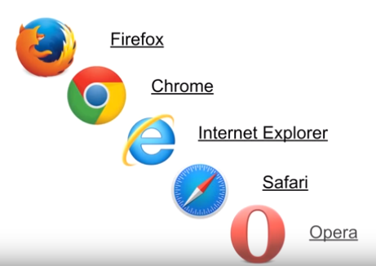
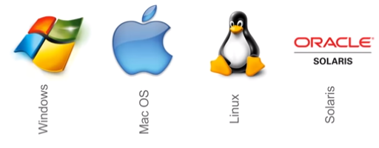
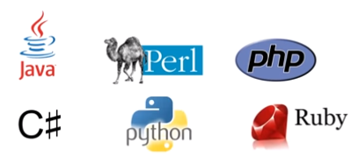
Selenium - Test Automation
Selenium - Supports
Browsers
OS
Language

Slide 34
Selenium - Test Automation
Selenium client-server architecture
Selenium Client includes:
  The WebDriver API, which is used to develop test scripts to interact with page and application elements
  The RemoteWebDriver class, which communicates with a remote Selenium server
Selenium Server includes:
  A server component, to receive requests from Selenium Client 's RemoteWebDriver class
  The WebDriver API, to run tests against web browsers on a server machine
  Selenium Grid, implemented by Selenium Server in command-line options for grid features

Slide 35
Selenium - Test Automation
Selenium Grid
Se Lib
iPad
M
Windows 10
Mac OS
CentOS

Slide 36
Selenium - Test Automation
Benefits
Faster Feedback
  It enhances communication between product owners, developers and designers
  Quick fix of malfunctions & bugs in real-time
Accelerated Results
  Testing can be executed on a repetitive basis, which in turn will deliver speedier results every time with minimized time and reduced effort
Reduced Business Expenses
  Time needed to execute tests will decrease dramatically
  Larger quantity of work can be undertaken in the same amount of time with greatly increased levels of accuracy
  This will directly reduce project costs

Slide 37
Selenium - Test Automation
Benefits Contd..
Testing Efficiency Improvement
  Testing occupies a considerable part of the whole Software Development Lifecycle
  So even the smallest improvement in the overall efficiency can result in a massive difference to the overall project timeline
Reusability of Automated Tests
Earlier Detection of Defects
  Early defect detection leads to cost-effective code rework
Faster Time-to-Market
  Time to market is a critical factor in product planning and success with regard to software applications
  Efficiency of test automation will reduce the time of project; which results you to hit market early

Slide 38
References
https://www.seleniumhq.org/docs/index.jsp/

Slide 39
Continuous Code Inspection
Code quality
Continuous code inspection = Constantly scanning code
Continuous code inspection is to Identify if any defects
It is a process of code review; however the goal is to prevent defects
Its been proved 90% of defects can be addressed using code inspections tools
Code Inspection & Testing?
  Testing verifies functionality and improves software quality
  Testing is expensive if you have to go through it over and over again
  By minimizing defects during code inspections, you can make your testing efforts more efficient
  If your code is complex, it may not be fully testable
  A code inspection, however, can find defects at the code level
Note: Even with automated testing, it takes time to verify functionality; by resolving defects at the code level, you’ll be able to test functionality faster

Slide 40
Continuous Code Inspection
Code Inspection Measures
Code inspections must be well-defined as per requirements:
  Functional requirements : User Needs : Cosmetic
  Structural requirements : System Needs : Re-engineering
Run Time Defects:
  Identify run time errors before program run
  Examples: Initialization (using the value of unset data), Arithmetic Operations (operations on signed data resulting in overflow) & Array and pointers (array out of bounds, dereferencing NULL pointers), etc.,
Preventative Practices:
  This help you avoid error-prone or confusing code
  Example: Declarations (function default arguments, access protection), Code Structure (analysis of switch statements) & Safe Typing (warnings on type casting, assignments, operations), etc.,
Style:
  In-house coding standards are often just style, layout, or naming rules and guidelines
  Instead using a proven coding standard is better for improving quality

Slide 41
Continuous Code Inspection
How to Improve Your Code Inspection Process
Involve Stakeholders
  Developer, Management & Customer
Collaborate
  Collaboration — both in coding and in code inspections
Recognize Exceptions
  Sometimes there are exceptions to the rule
  In an ideal world, code is 100% compliant to every rule in a coding standard
  The reality is different
Document Traceability
  Traceability is important for audits
  Capture the history of software quality
What to Look For in Code Inspection Tools
Automated inspection
Collaboration system

Slide 42
Agenda
SonarQube - Continuous Code Inspection Tool
SonarQube Quality Gate
Continuous Inspection
Focus on the Leak
Enforce Quality Gate
Benefits of SonarQube

Slide 43
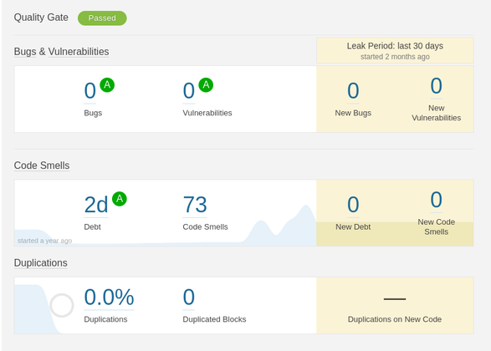
SonarQube - Continuous Code Inspection Tool
SonarQube Quality Gate
SonarQube provides the capability to not only show health of an application but also to highlight issues newly introduced
With a Quality Gate in place, you can fix the leak and therefore improve code quality systematically

Slide 44
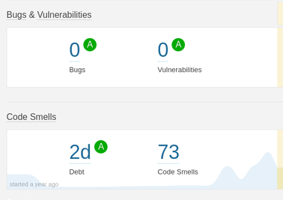
SonarQube - Continuous Code Inspection Tool
Continuous Inspection
Overall health
  Tools shows overall health of the application
  Also it shows good results achieved over time
Terminology:
  Bug:
    An issue that represents something wrong in the code
    If this has not broken yet, it will, and probably at the worst possible moment
  Code Smell:
    A maintainability-related issue in the code
    Leaving it as-is means that at best maintainers will have a harder time than they should making changes to the code
    At worst, they'll be so confused by the state of the code that they'll introduce additional errors as they make changes
  Vulnerability:
    A security-related issue which represents a backdoor for attackers

Slide 45
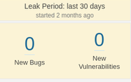
SonarQube - Continuous Code Inspection Tool
Focus on the Leak
Once that Leak is under control, code quality will start improving systematically
Leak is a built-in concept that you can’t miss
Once you’ve had a look at this yellow area on the left of your project home page, you will always remain focused on it to not miss any new issues
Water Leak Paradigm:
  Situation: Kitchen Water Leak
    Do you reach out to mop?
  OR
    Do you find the source and fix?
Note: Same logic should be used for Code

Slide 46
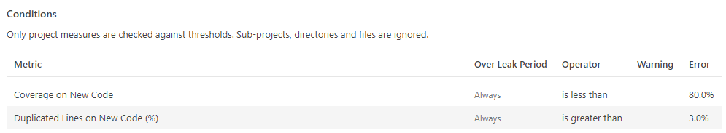
SonarQube - Continuous Code Inspection Tool
Enforce Quality Gate
To fully enforce a code quality practice across all teams, you need to set up a Quality Gate
A set of requirements that tells whether or not a new version of a project can go into production
SonarQube’s default Quality Gate checks what happened on the Leak period and fails if your new code got worse in this period
A quality gate is the best way to enforce a quality policy in any organization
Define a set of Boolean conditions based on measure thresholds against which projects are measured
It supports multiple quality gate definitions

Slide 47
SonarQube - Continuous Code Inspection Tool
Analyze pull requests
To shorten the feedback loop, you can set up the analysis of your pull requests
Analyses will be run on your feature branches without being pushed to SonarQube
This gives you the opportunity to fix issues before they ever reach SonarQube

Slide 48
Benefits of SonarQube
Branch Analysis
Track the quality of short-lived and long-lived code branches in SonarQube to ensure that only clean, approved code gets merged into master

Slide 49
References
https://docs.sonarqube.org

Slide 50
Thank You!
In our next session:

